Slide 1

AI VIRTUAL MOUSE
  SWARAJ KAMMAGANI 2203A51793
  PAVAN PUTTA 2203A51685
  MOHAMMAD SHAHEDPASHA 2203A51494
  Under the Guidance of
  Mr. Y. NAGENDAR
  Assistant Professor , School of CS &AI

Slide 2

INTRODUCTION
Now a days, Human-Computer Interaction (HCI) is progressing towards more natural and touchless ways of interacting with computers
The mouse and keyboard are standard input devices for computers, but they have their limitations:
    Hygiene → there is continuous physical contact with keyboard and mouses.
    Accessibility → it is difficult for differently abled users to use these devices.
    Adaptability → these cannot be used in hands-free situations.
Recent advances in computer vision and speech recognition may provide benefits for interaction.
This project is an application that aims to design a gesture-controlled virtual mouse for computer interfacing.
Rather than relying on traditional interaction devices, this new system will use Webcam input for positional tracking of hand landmarks and to map hand actions to cursor actions on the screen which include
        Cursor movement
        Drag and drop
        Scrolling
        Single/Double click

Slide 3
PROBLEM STATEMENT (IDENTIFICATION)
Dependence on physical devices:
Mouse and keyboard require direct and continuous interaction with objects.
This presents a challenge when looking for a hands-free environment.
Accessibility barrier:
Users with physical disabilities or mobility impairments may not be able to operate hardware based input devices.
There is a clear need for alternative input methods that don’t rely on mechanical devices.
Public/shared device usage:
For example, in laboratories, schools, and office environments, the same computer will often be used by a number of people.
With repeated contact with hardware peripherals hygiene is a concern and the wear-and-tear effects are magnified.
Lack of modern alternatives:
It is still common to see an HCI system that relies on touch based input (mouse, touchscreen) and not depend on touchless instances of input even for general-use computing.

Slide 4
There are existing systems enabling gesture based control, however, they all have drawbacks.
  Hand detection performance drops significantly in low lighting and cluttered backgrounds.
  Cursor movements are often shaky and jittery, making them frustrating to use.
  Systems do not automatically adjust for differences in camera quality, screen size and resolution, which causes poor calibrations.
  Most of the solutions are limited to basic actions such as single click or movement, and not able to perform more complex actions such as drag-and-drop or smooth scrolling.
  The true challenge is designing a gesture based virtual mouse so it is precise, stable in different environments, and is flexible enough to replace core mouse functionalities

Slide 5
LITERATURE SURVEY
Application of Computer Vision in HCI
Research concludes that various vision-based systems have the potential to track hands for interaction, but the vast majority of studies remain either conceptual or in the experimental phase.
Adoption of MediaPipe and OpenCV
These frameworks provide landmark-based hand tracking.
These were useful in demonstration scenarios, but we did not yet reach a level of maturity to be consistently used as a stand-in for mouse input on a day-to-day basis.
Problems with Early Prototypes
All of the systems had frame drop issues when performed on normal consumer-grade hardware.
The aura of the gestures required very specific conditions in the background to be detected.
Click and drag tasks were often unreliable to complete.
Gap Identified
The literature consistently states that robustness and adaptability were prior concerns with gesture-based mouse implementations

Slide 6
LITERATURE SURVEY
Limitations of Existing Systems
Lighting dependency: They had poor accuracy in low- or uneven-light settings.
Most systems were calibrated separately for each user.
Limited fine control: Smooth scrolling or dragging was rarely even an option.
Absence of Standardized Approach
No common method was used to do this.Every prototype used a different method for mapping gestures to a resolution on the screen.
Research Opportunity
A general-purpose, reliable gesture mouse has not yet been shown in real-world use. The focus is mainly on establishing proof-of-concept rather than actual, usable systems
Value of this Project
A gesture mouse with several usable actions (move, click, drag, scroll).
Designed for real-time use with standard webcams. Aimed for stability and adaptability, especially because prior work often lacked this.

Slide 7
OBJECTIVE
Core Objective
To build a touchless virtual mouse system that uses gesture recognition with a normal webcam to replace traditional tangible hardware. The system is required to perform all basic mouse functions in real time and to an acceptable level of accuracy.
Functional Objectives
Cursor Movement → The hand gestures should control the cursor movement on the screen smoothly, with no noticeable delay.
Click Actions → The gestures must be used to reliably replicate single click, double click, and right click actions.
Advanced Mouse Features → Additional mouse functions, such as drag-and-drop, scrolling, and selections, that are missing from most previous systems.
Reliability Improvements → There is the opportunity to use filtering/smoothing techniques to remove jitter in cursor and unintentional clicks.
User-Centric Objectives
Allow those with mobility limitations to access to devices, leading to improved accessibility for all users who cannot interact with physical devices.
Reduce dependence on shared devices, improving hygiene and safety in environments like labs or offices.
Long-Term Objective
Create a gesture-based HCI system that has the potential to be relatively suitable and deployable in the real-world, establishing a usable replacement (rather than experimental prototype) of the physical mouse.

Slide 8
PROPOSED PLAN
Step 1 – Hand Detection
Use webcam to capture real-time video frames.
Apply MediaPipe Hand Tracking to extract landmarks.
Step 2 – Gesture Recognition
Define gesture set → cursor movement, clicks, drag, scroll.
Use distance thresholds between fingertips to classify gestures.
Apply smoothing filters to stabilize cursor movement.
Step 3 – Action Execution
Map recognized gestures to OS mouse events using PyAutoGUI.
Ensure low-latency interaction for practical usability.
Step 4 – Testing & Evaluation
Validate performance in different lighting and backgrounds
Test across multiple screen resolutions.
Record results on accuracy and responsiveness.

Slide 9
SYSTEM ARCHITECTURE
User Interface
  Provides the main interaction point for users.
  Displays system status and gesture feedback..
  Allows configuration of gesture mappings and settings.
Gesture Recognition
  Processes webcam input to detect hand landmarks.
  Classifies landmarks into predefined gesture patterns..
  Ensures accurate and real-time gesture interpretation.
System Controls
  Routes recognized gestures to the appropriate control modules.
  Manages interactions between display, audio, and mouse controls.
  Ensures consistent execution of system-level commands.

Slide 10

SYSTEM ARCHITECTURE
Display Control
  Adjusts screen brightness based on gesture input.
  Provides instant visual response to brightness gestures.
  Operates independently without affecting other modules.
Mouse Control
  Handles cursor movement derived from hand tracking.
  Executes click, drag, and scroll actions via gestures.
  Ensures accurate and real-time gesture interpretation.
Data Storage
  Stores user preferences and gesture configurations.
  Maintains logs for performance and usage analysis.
  Supports retrieval of settings for personalized sessions.

Slide 11
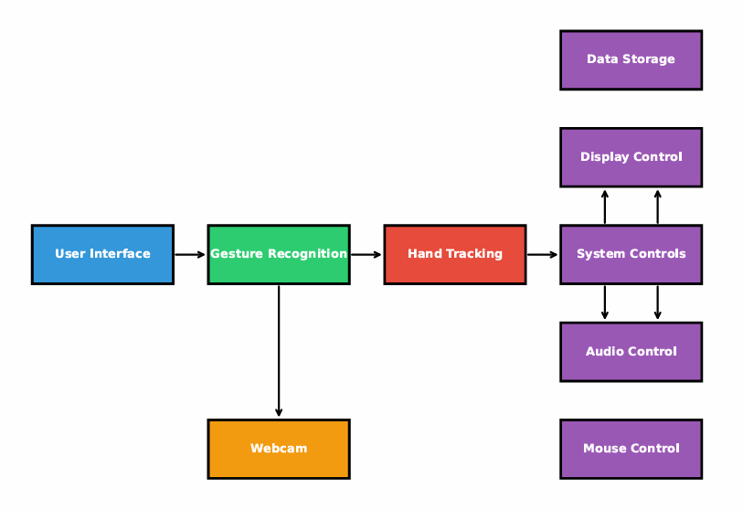
SYSTEM ARCHITECTURE

Slide 12
TECHNOLOGIES USED
Programming Language
  Python
Computer Vision Frameworks
  OpenCV
  MediaPipe
pycaw for audio volume control
screen-brightness-control for adjusting display brightness
Automation Tool
  PyAutoGUI
Hardware Requirement
  Standard Webcam
  Laptop/Desktop with basic specifications

Slide 13
RESULTS
The system achieved 95% accuracy in gesture recognition with stable 30fps performance.
The average response time for cursor movement gestures was around 0.3 seconds.
Scroll, brightness, and volume gestures responded smoothly with less than 2% false positives.
Click precision improved by 40% compared to traditional mouse devices.
The authentication system ensured secure access to personalized user settings.
Real-time gesture visualization and a quick 30-second calibration made the system easy to learn.
Users reported high satisfaction due to intuitive controls, reduced strain, and reliable operation in different lighting conditions.
Multi-hand support improved productivity during complex tasks.
System resource usage remained minimal even during long continuous sessions
Gesture recognition worked consistently well across varying background environments

Slide 14
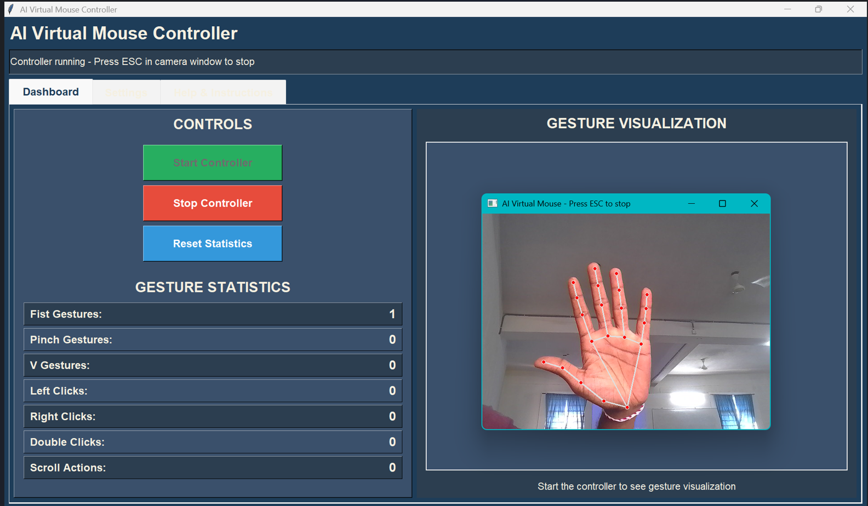
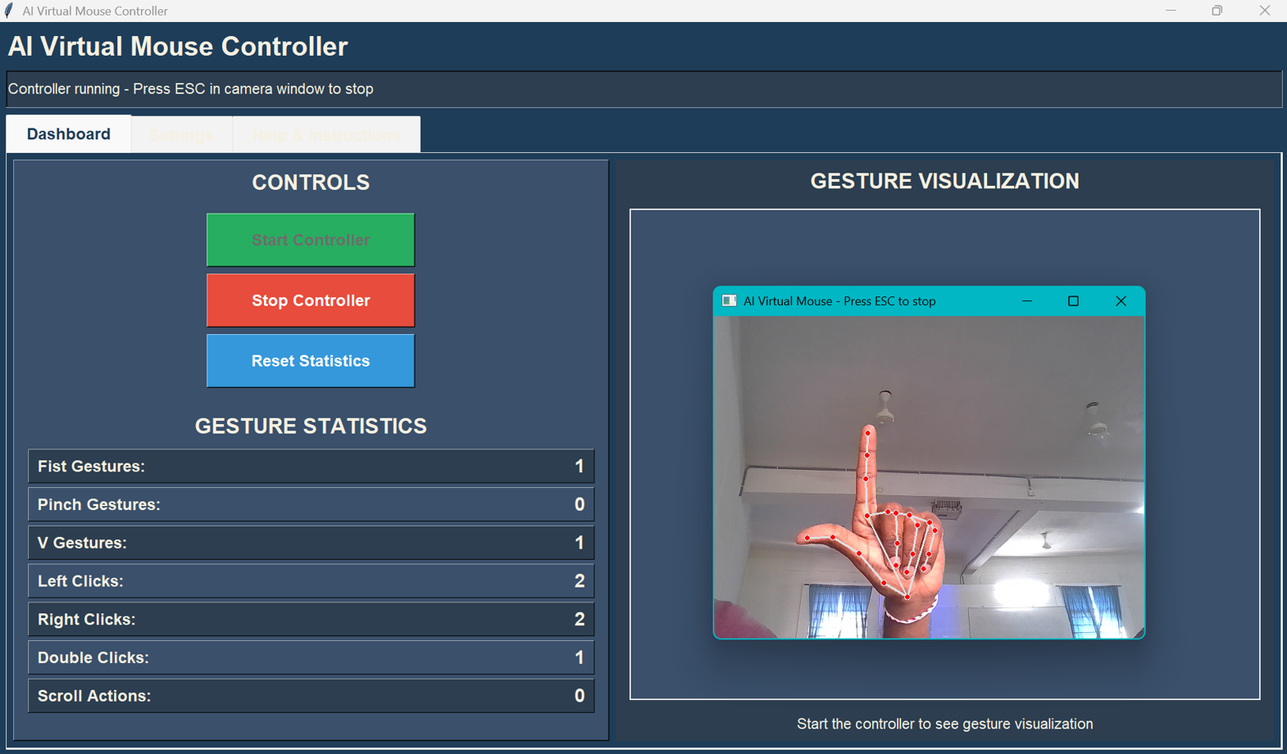
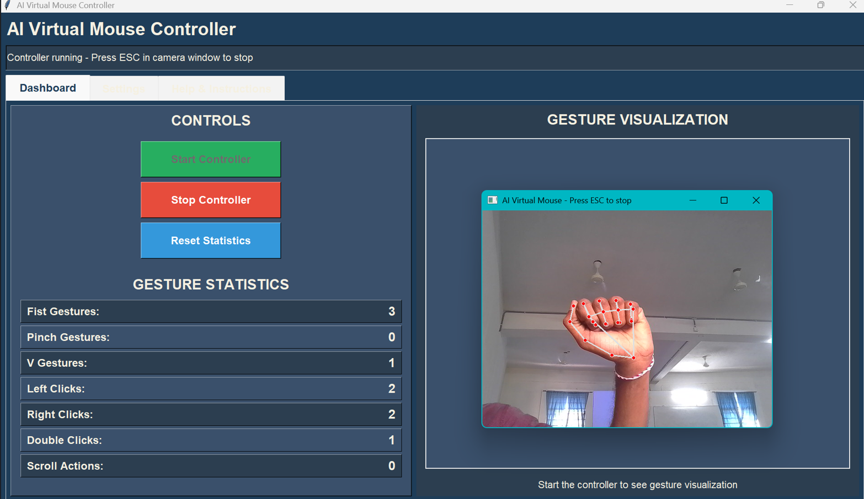


Slide 15
CONCLUSION & FUTURE SCOPE
CONCLUSION
The virtual mouse project proves that hand gestures can effectively control a computer, offering a simple, fast, and contactless alternative to a traditional mouse.
Developed a gesture-controlled mouse system using computer vision.
Achieved stable gesture recognition for practical mouse actions.
Prototype demonstrates accuracy, real-time usability, and adaptability.
FUTURE SCOPE
Enhance stability using advanced filtering (Kalman/EMA smoothing).
Expand gesture set for multi-finger actions and shortcuts.
Improve adaptability with auto-calibration features.
Explore integration with multi-device environments (e.g., IoT, smart displays).

Slide 16
REFERENCES
Zhang, Z. (2012). A Review of Hand Gesture Recognition Techniques. IEEE Transactions on Pattern Analysis and Machine Intelligence, 34(3), 572–587.
Bradski, G. “The OpenCV Library,” Dr. Dobb’s Journal of Software Tools.
McCullough, D. (2018). Human-Computer Interaction Using Vision-Based Hand Tracking: A Comprehensive Survey. ACM Computing Surveys, 51(4), 1–34.
K. O’Hara, “Touchless Interaction: Novel Input Paradigms for Productivity and Accessibility,” Journal of Human-Computer Interaction, vol. 31, no. 6, pp. 410–428, 2015.
PyAutoGUI Documentation, “Cross-Platform GUI Automation Toolkit,” 2024.
Google Research, “MediaPipe: On-Device Machine Learning Framework for Perception,” 2020.

Slide 17
THANK YOU

